Slide 1
Greater Manchester Nutrition and Hydration programme
Preventing avoidable harm
Maintaining independence
Improving health and quality of life
Kirstine Farrer
Consultant Dietitian, Salford Royal
Emma Connolly
Programme Director, Age UK Salford
@GMNandH

Slide 2
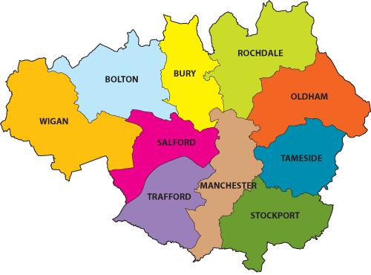
Greater Manchester Nutrition and Hydration Programme
Area Public Health Lead Project Worker
Bolton Gary Bickerstaffe Nicola Calder
Bury Francesca Vale Carmel Berke
Oldham Julie Holt Marie Price
Rochdale Adam Sutcliffe Martin Hazlehurst
Stockport Hayley Taylor-Cox Siobhan McKenna

Slide 3
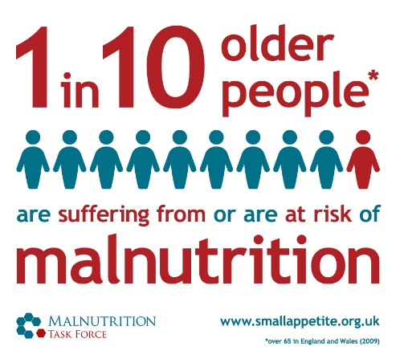
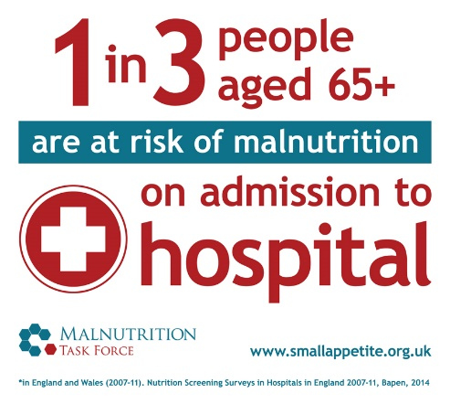
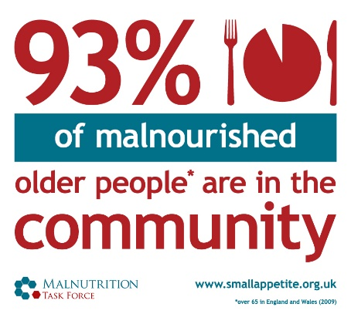
Overview – why focus on malnutrition?
It’s a hidden problem – 1 million people (1 in10) over the age of 65 are at risk of malnutrition and 93% of these are living at home
It’s all around us - A third of recent arrivals to hospitals and care homes are already malnourished (or at risk)
The consequences - For every 10 days a person over the age of 80 is in hospital they lose 10% of muscle mass
It is preventable – Losing weight is not a natural part of growing old
It’s expensive – Malnutrition costs the health and social care system around £20bn per year
Notes:
14% of people living in the community are suffering from or at risk of malnutrition. It usually develops over the medium to long term and often goes unidentified and therefore untreated until it becomes a serious problem and people are admitted to hospital or a care home because their health and independence have deteriorated.
At the point of admission to hospital the prevalence rises to a third and on admission to care homes it is as much as 35% of people who are at risk. We can see, therefore, the direct link between malnutrition, consequences for the individual’s health, wellbeing and quality of life and cost to the health and care services.
We have a wide range of services that interact with older people who may notice if someone is looking thin or has lost weight, however, it is not common for this to be raised as an issue – partly due to the myth that losing weight is a natural part of ageing and partly due to lack of knowledge of how to support.
The GM Nutrition and Hydration programme aims to flip this situation on its head – to provide free training and simple tools and information so that everyone working with or caring for older people have the knowledge they need to identify malnutrition and to enable the person to take a self-care approach to stimulating weight gain.

Slide 4
Why does it happen ?
Social risks
Loneliness
Not worth cooking just for one
“My wife always did the cooking”
Physical risks
Dentition
Poor mobility and lack of access to local shopping
Ability to prepare food and eat independently
Medical risks
Crohn’s disease
Cancer
Dementia
In many cases it’s preventable and treatable and not a natural consequence of old age!

Slide 5
Malnourished people: the consequences

Slide 6
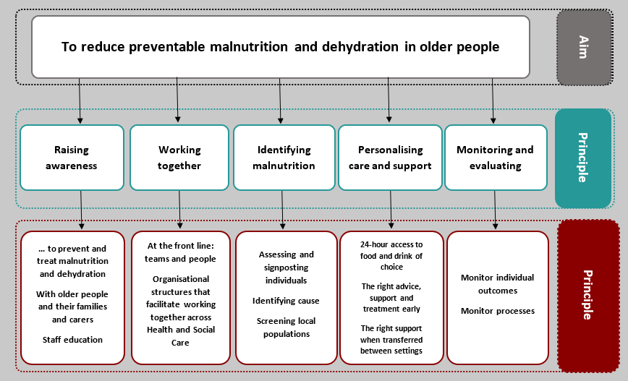

Slide 7
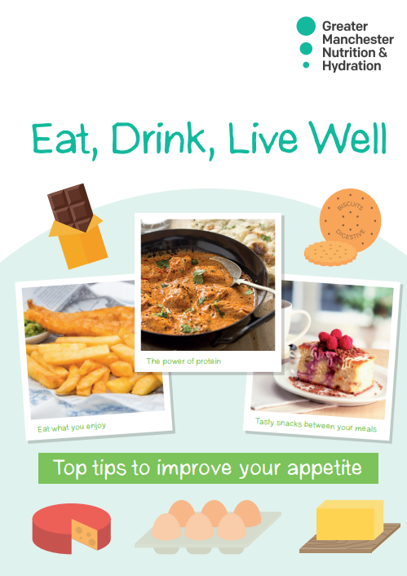
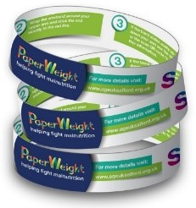
Community-based intervention
Red flag questions
1 hour training available

Slide 8
E-learning tool for Malnutrition and Swallowing Difficulties – www.paperweightarmband.org.uk

Slide 9
Could you help?
How could commissioning processes be used to reduce malnutrition and dehydration?
Promote the e-learning tool and/or build into KPIs for specific organisations related to completion
Support us to embed the conversations around nutrition and hydration in our services
Can you endorse the approach to encourage participation and/or build this into contracts?
Can you recommend organisations for training?
Could you reach out to the local steering group to find out what specific barriers they are facing?
Raise the profile of the importance of eating and drinking well and how organisations can promote this
Commissioning services which promote good nutrition and hydration or address the causes – e.g. social eating opportunities, shopping services, meal delivery, bereavement support

