Slide 1
Nutrition and hydration in later life
A Greater Manchester ‘ageing well’ population health programme

Slide 2
Why focus on nutrition and hydration?
One in ten people aged over 65 in the UK (1.3 million) is malnourished or at risk of malnutrition.
It is not generally well understood or recognised amongst the community at large
But it can undermine health and physical resilience in later life
Launching in the same week as the International Day of Older Persons, the first ever UK Malnutrition Awareness Week ‘MAW’ 1-7 October seeks to raise awareness of the ‘hidden’ problem of malnutrition in older people.

Slide 3
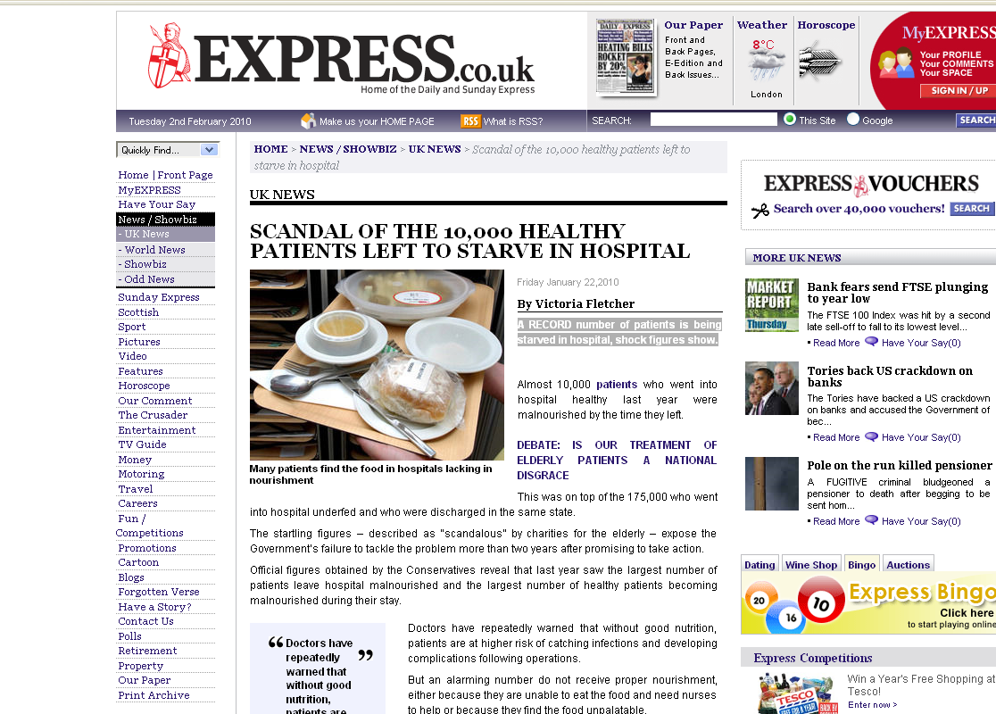
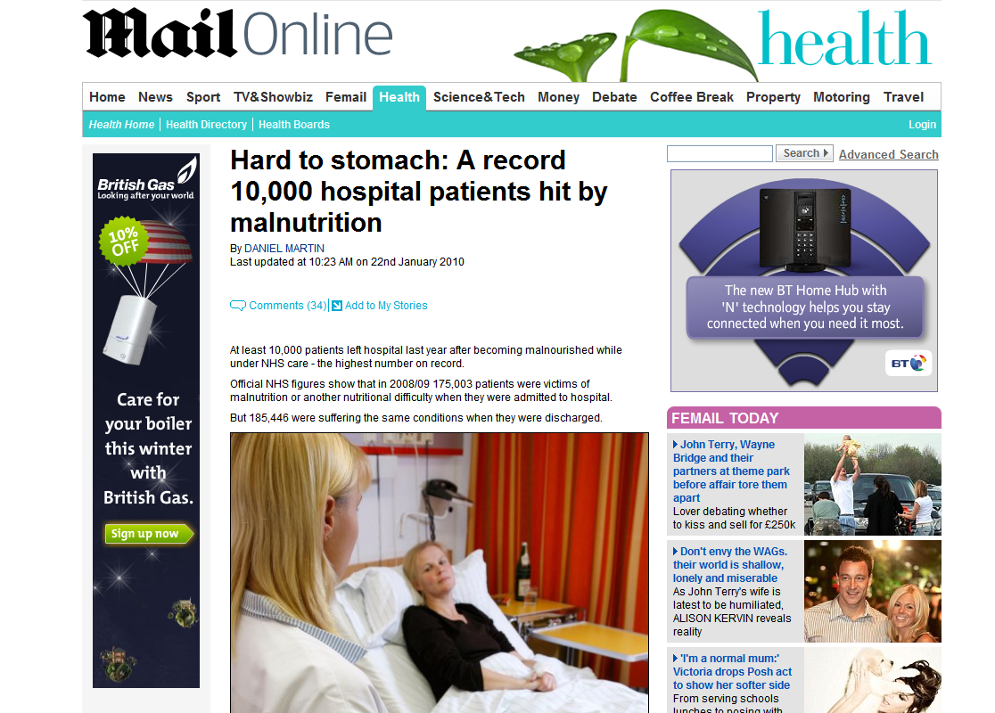
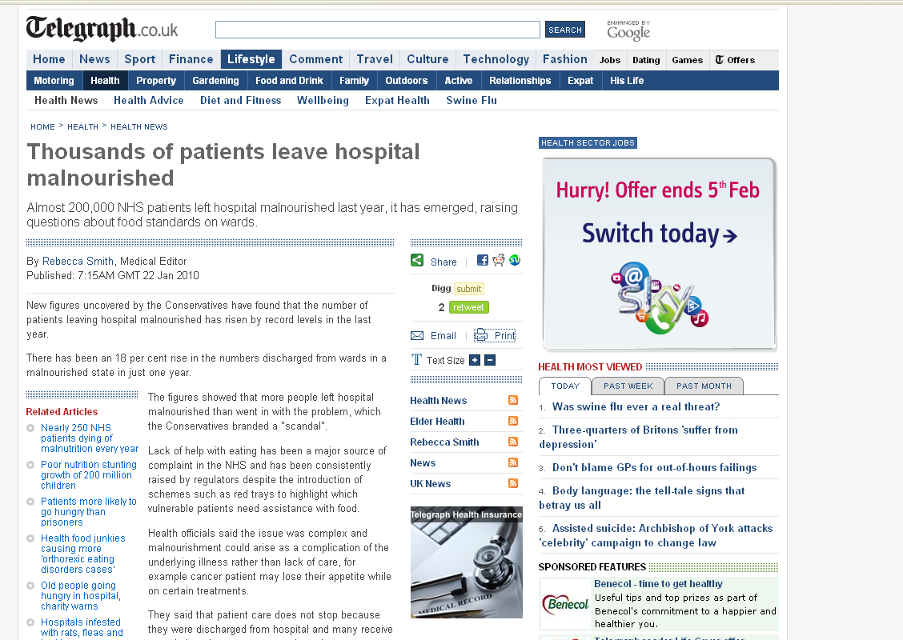
Notes:
3

Slide 4
What’s the problem?
Malnutrition is common in the UK, affecting more than three million people at any one time
1 in 3 patients admitted to acute care will be malnourished or at risk of becoming
35 percent of individuals admitted to care homes will also be affected
93% of those at risk of, or suffering, from malnutrition will be living in the community
Dehydration is linked to several known causes of harm, but we don’t know its scale in the UK
Malnutrition costs the UK health economy an estimated £20 billion per year*
Improved identification and treatment is in the top 3 for possible cost savings for the NHS**
* BAPEN, 2015
** The National Institute for Health and Care Excellence (NICE) 2011
http://www.malnutritiontaskforce.org.uk http://www.england.nhs.uk
Notes:
Key messages
1. Malnutrition is common - affects 3 million people
2. 93 % of those at risk or suffering from malnutrition live in the community
3. It costs the UK health economy 20 billion a year

Slide 5
Who is at risk?
Communities - little or no contact with services
Care Homes
Hospital
Communities in contact with services
93%
3 million malnourished
5%
2%
Notes:
Lead: Janine

Slide 6
Our focus in Greater Manchester
To support a genuine population health ‘brief intervention’ targeting the older adult population
Roll out and expand Salford’s innovative ‘paperweight’ armband to 5 other boroughs
Test and evolve, developing strategies to address malnutrition and dehydration from the bottom up
Learn together and share knowledge and practice
Evaluate the application and effectiveness of a community centred programme (vs healthcare-led)
Produce a replicable approach to reducing malnutrition and dehydration

Slide 7
The Five Principles
Raising awareness
Working together
Identifying malnutrition
Monitoring and evaluating
Personalised care, support and treatment

Slide 8
#MAW 2018 calls for members of the public to:
Be clear that losing weight is not a normal part of ageing - spread the message that unexplained weight loss should be taken seriously as it can have a significant impact on health and quality of life.
Look out for your relatives, friends and neighbours - recognise the signs and symptoms of unexplained weight loss including subtle signs such as loose clothing and jewellery, dentures not fitting properly or a smaller appetite
The campaign also calls on all organisations of influence and policy makers to:
Drive public awareness, deliver better training for professionals
Increase awareness of the hidden problem of dehydration, improve access to good dentition, and ensure older people have help with eating and drinking when they need it
Provide more support for older people experiencing the transitions of later life

Slide 9
Question 1
What is the cost of malnutrition to health and social care in Greater Manchester?
£1.2 million
£1.1 billion
£12 billion

Slide 10
Question 2
According to Managing Adult Malnutrition in the Community, what percentage of people recently admitted to care homes are malnourished?
20%
30%
35%

Slide 11
Question 3
What percentage of over 75s go 3 months or longer without eating a meal with anyone else?
5%
15%
20%

Slide 12
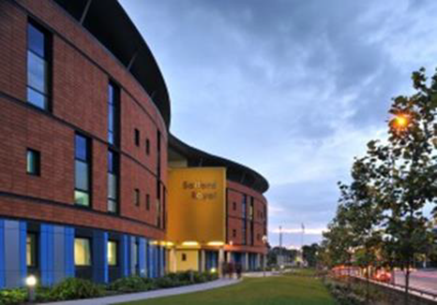
The Salford Journey
Kirstine Farrer – Consultant Dietitian
Dave Haynes – Chief Executive Age UK Salford

Slide 13
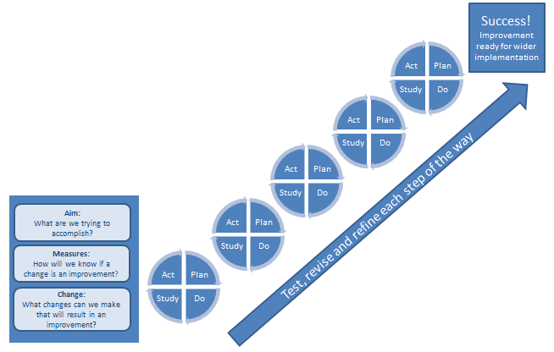
Our approach – Align with Integrated Care Organisation programme
Governance
Integral part of integration agenda in Salford
Monthly reporting to the ICP Operations Board and Bi Monthly
Reporting to the ICP Alliance Board
Methodology
Model for Improvement using PDSA cycles
Workstream Remits & Action Plans

Slide 14
Hospital admissions for malnutrition by Greater Manchester local authority residents, directly standardised rate per 100,000; three year average 2013-16 to 2015-18

Slide 15
Average (mean) length of stay in days of hospital admissions for malnutrition; Greater Manchester residents, three year periods 2013-16 to 2015-18

Slide 16
Work Stream Remits
ICP Standards of Nutritional Care Across Organisations to reflect the NIHCE Quality Standards
Nutrition and Dysphagia Education for Staff across Salford ICP
Raising Awareness
Working with Community and Primary Care

Slide 17
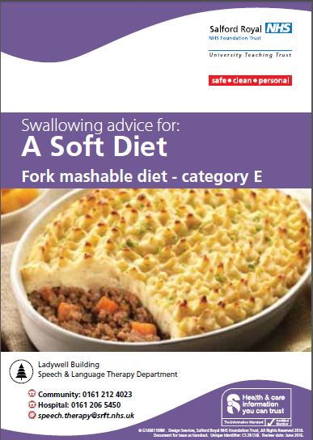
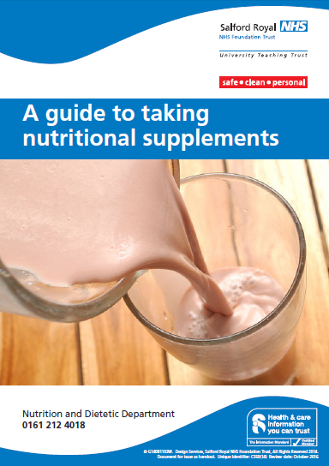
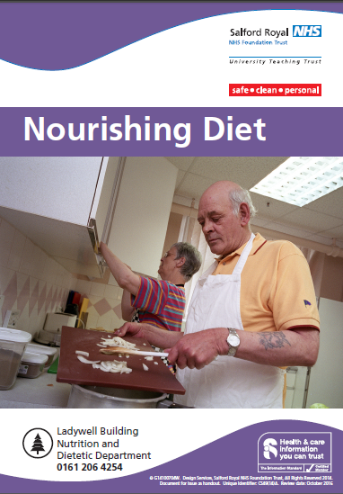
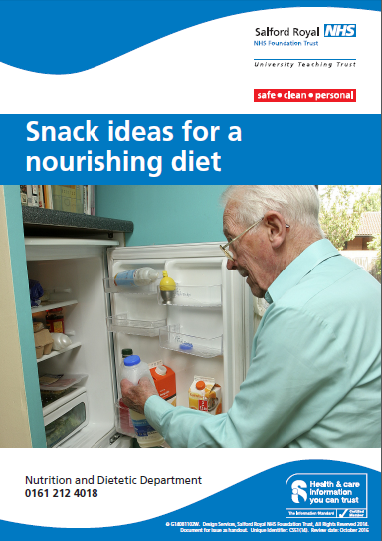
Raising Awareness
Diet sheets developed for acute and community settings written by older adults, dietitians and speech and language therapists

Slide 18
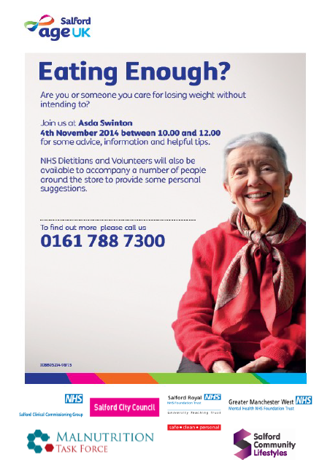
Progress
Shopping Trip
First shopping trip took place in November – six people in attendance
Preparation included:
Targeting appropriate older people to attend
Discussions with ASDA regarding preparation for the day
Pull up poster purchased to have on show at the event to encourage others to find out more
Leaflets available
Development of floor plan for ASDA in Swinton
Information on what to look out for in each aisle
Attendees rewarded with a cup of tea and biscuit for participating.
Staff on hand to support (community dietitians, dietetic assistants, AgeUK etc)
Film clip developed:
http://communityreporter.net/videos/malnutrition-task-force-trip-asda

Slide 19
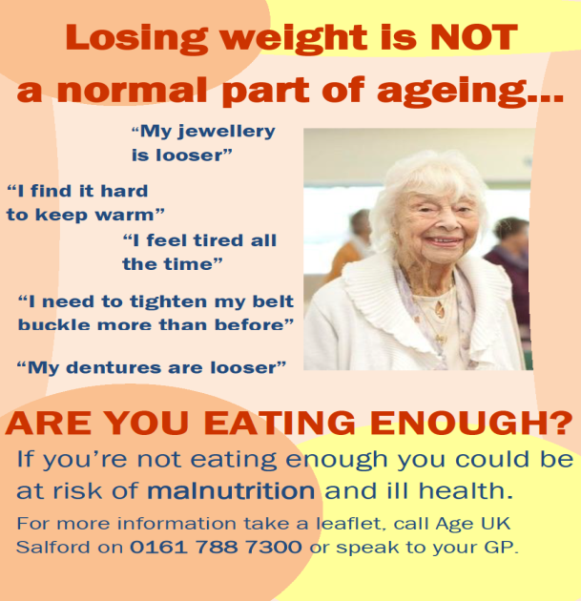
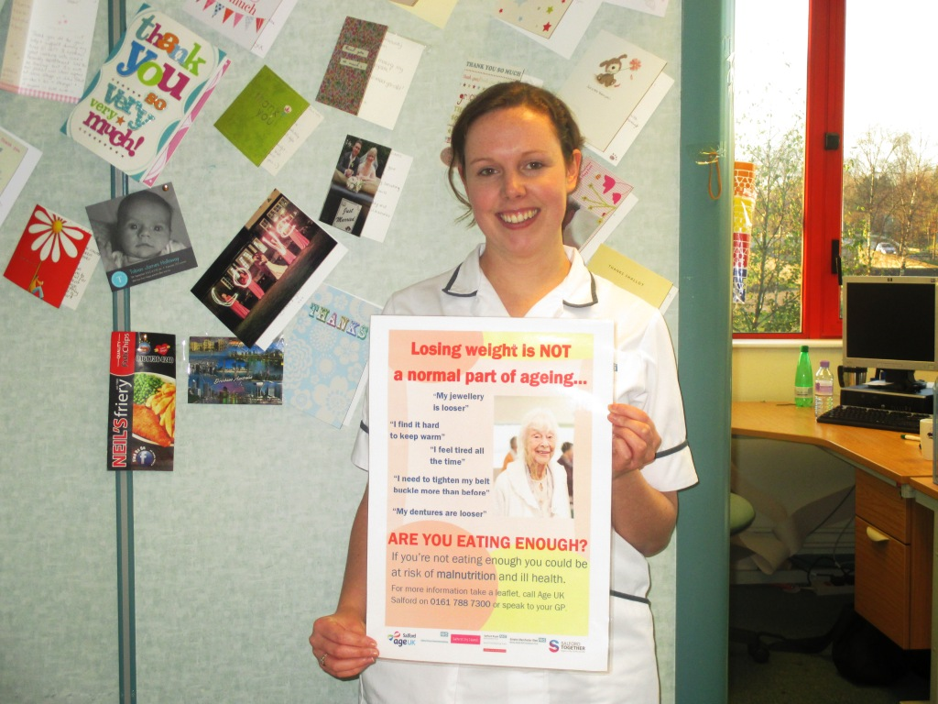
Progress
Patient Information Displays
10 GP practices identified as high volume of sip feed prescribing
Poster developed by dietitian and Age UK Salford
Leaflets previously outlined will be included
Floor plans and isle information for both ASDA and Morrisons supermarkets and given to patients at the time of their consultation
Social prescribing fridge magnets and postcards to swap for coffee and cake!

Slide 20
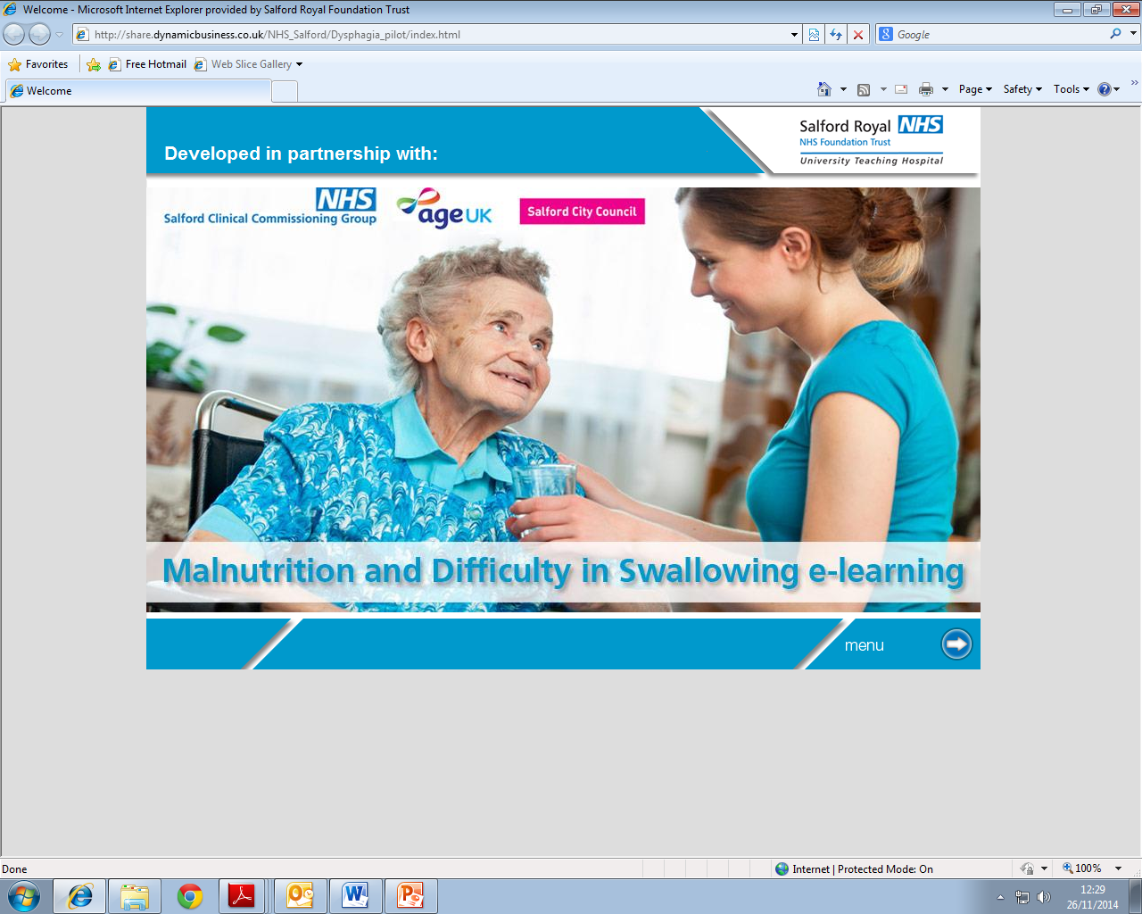
Nutrition and Dysphagia Training

Slide 22
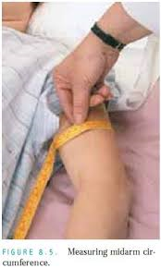
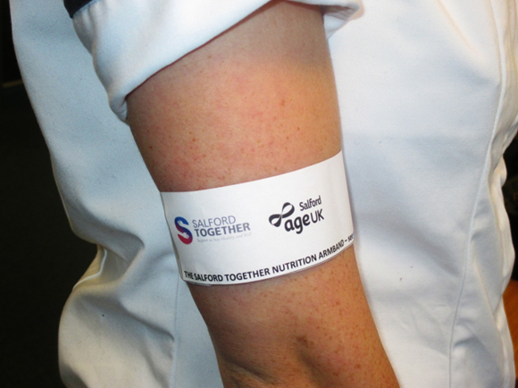
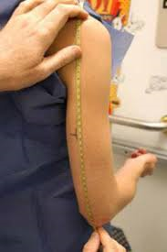
Prototype March 2015

Slide 23
The ‘science’
Does not replace validated screening tools – ‘raising awareness’ – public health signposting tool
Dietetics – well known upper arm circumference can be a surrogate measure for Body Mass Index.
Percentile charts for MAC available – accuracy of measurement due to inter observer error
Useful in bed bound patients
clinical outcome measure
Used routinely on the intestinal failure unit and with long term patients

Slide 24
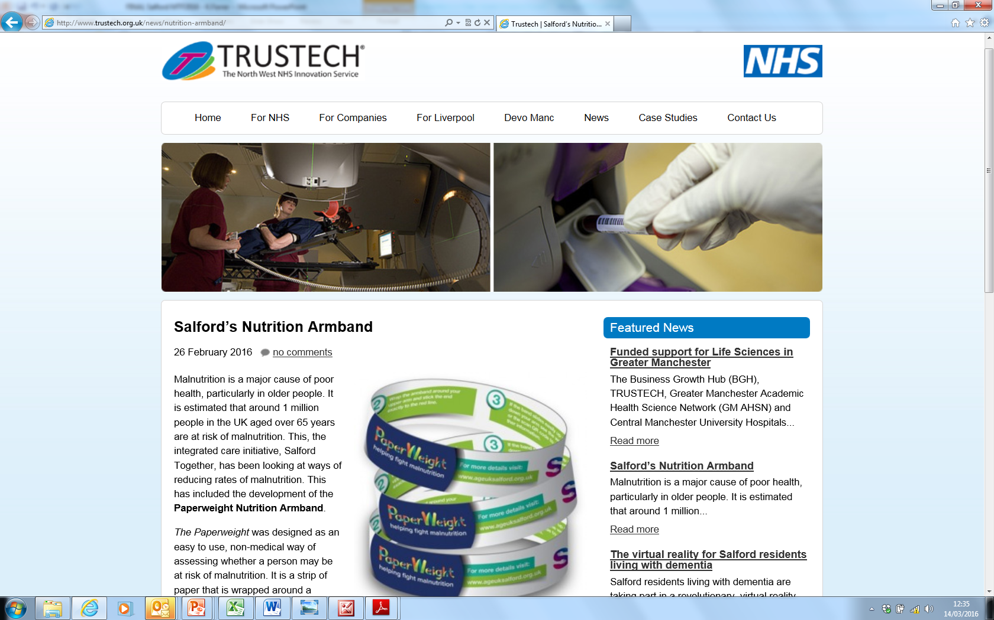

Slide 25
Email us – paperweight@ageuk.salford.org.uk

Slide 26
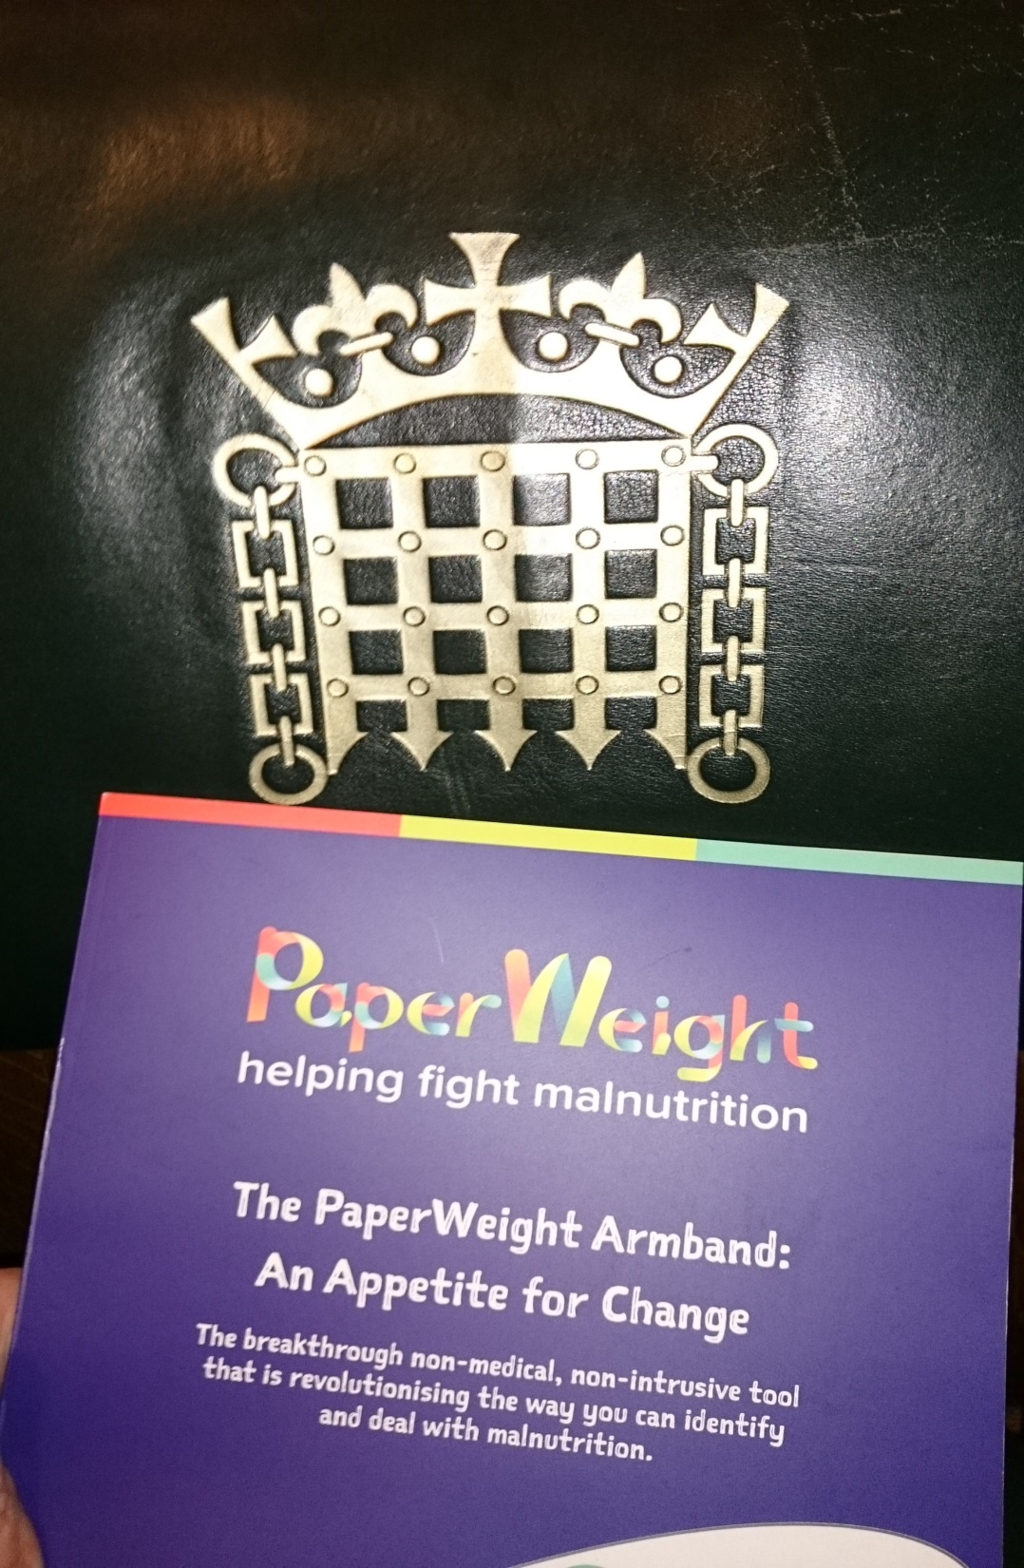
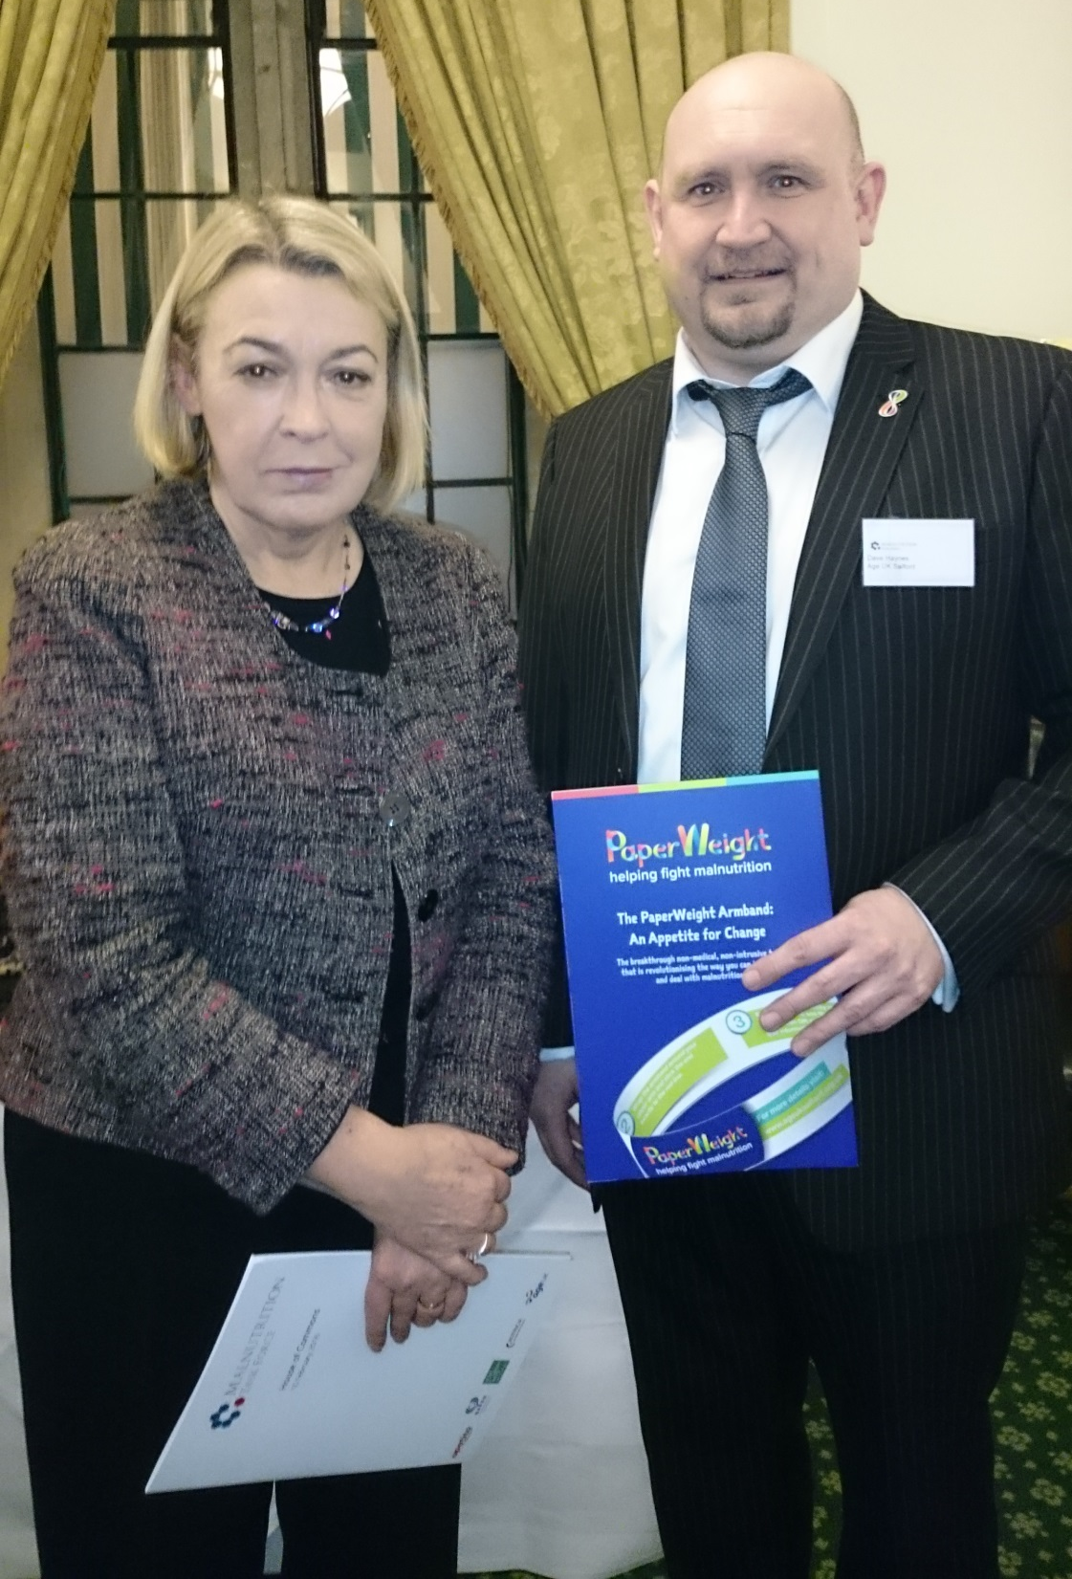
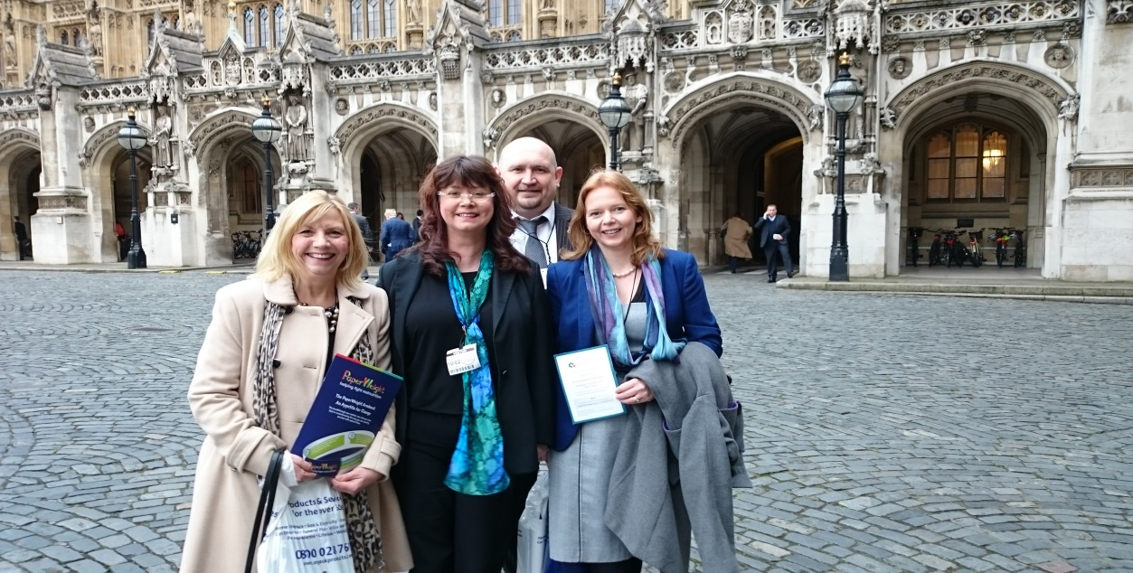

Slide 27
Salford MTF Steering Group 2018
Name | Job Title | Place of work
David Haynes | Chief Executive | Age UK, Salford
Jean Rollinson | Director of Service Development | Age UK, Salford
Emma Connolly | Programme Director Nutrition and Hydration | Greater Manchester Health and Social Care Partnership Age UK Salford
Kirstine Farrer | Consultant Dietitian | Salford Royal NHS Foundation Trust
Brenda Blackett | Lead Nutrition Nurse | Salford Royal NHS Foundation Trust
Tony Ward | Team Leader, Community Dietetics | Salford Royal NHS Foundation Trust
Bernadette Elder | Chief Executive Officer | Inspiring Communities Together
Claire Vaughan | Head of Medicines Optimisation | NHS Salford Clinical Commissioning Group
Helen Dugdale | Public Health Strategy Manager | Salford City Council

Slide 28
Greater Manchester Nutrition and Hydration programme
Emma Connolly
Programme Director
@GMNandH

Slide 29
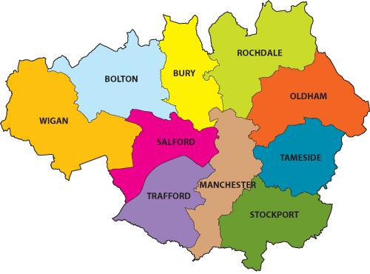
Greater Manchester Nutrition and Hydration Programme
5 localities: Bolton, Bury, Oldham, Rochdale, Stockport
2 year pilot
GM Leadership – GM steering group, Salford MTF, Age UK Salford
Local leadership – Public Health leads, local Age UK and multi-agency steering groups
Project team support roll out

Slide 30
Greater Manchester Nutrition and Hydration Programme
Area Public Health Lead Project Worker
Bolton Gary Bickerstaffe Nicola Calder
Bury Francesca Vale Carmel Berke
Oldham Julie Holt Marie Price
Rochdale Adam Sutcliffe Martin Hazlehurst
Stockport Jen Connolly Siobhan McKenna

Slide 31
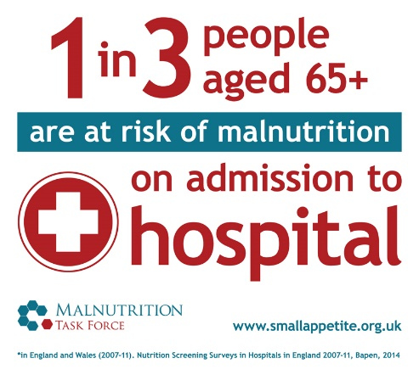
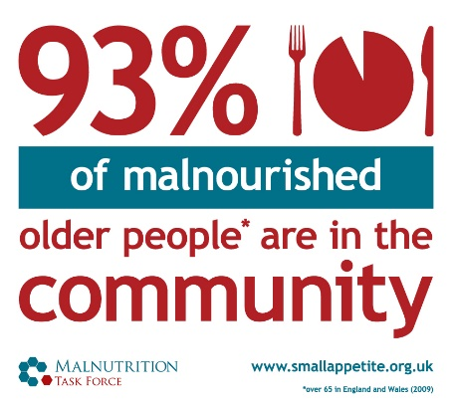
Background
It’s a hidden problem – 1 million people (1 in10) over the age of 65 are at risk of malnutrition and 93% of these are living at home
It’s all around us - A third of recent arrivals to hospitals and care homes are already malnourished (or at risk)
The consequences - For every 10 days a person over the age of 80 is in hospital they lose 10% of muscle mass
It is preventable – Losing weight is not a natural part of growing old
Notes:
14% of people living in the community are suffering from or at risk of malnutrition. It usually develops over the medium to long term and often goes unidentified and therefore untreated until it becomes a serious problem and people are admitted to hospital or a care home because their health and independence have deteriorated.
At the point of admission to hospital the prevalence rises to a third and on admission to care homes it is as much as 35% of people who are at risk. We can see, therefore, the direct link between malnutrition, consequences for the individual’s health, wellbeing and quality of life and cost to the health and care services.
We have a wide range of services that interact with older people who may notice if someone is looking thin or has lost weight, however, it is not common for this to be raised as an issue – partly due to the myth that losing weight is a natural part of ageing and partly due to lack of knowledge of how to support.
The GM Nutrition and Hydration programme aims to flip this situation on its head – to provide free training and simple tools and information so that everyone working with or caring for older people have the knowledge they need to identify malnutrition and to enable the person to take a self-care approach to stimulating weight gain.

Slide 32
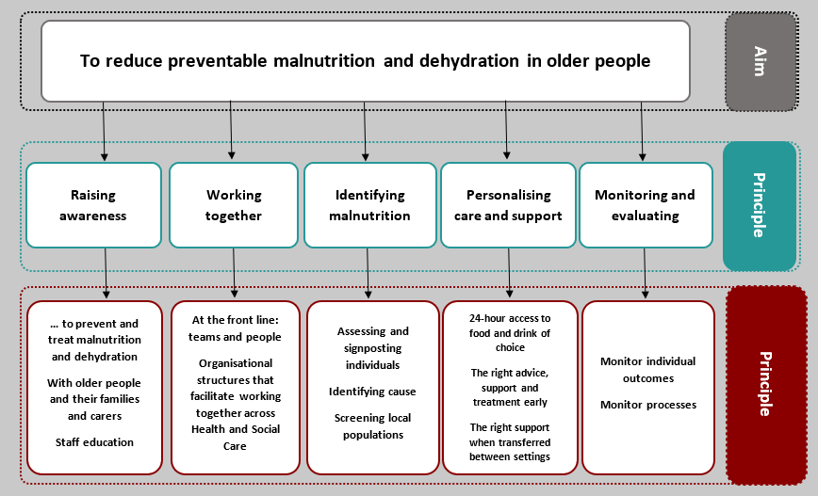

Slide 33
Large scale public health intervention
30% positive outcome
40,000 people assessed
80% of care home staff
Wide range of organisations

Slide 34
Brief intervention
Red flag questions

Slide 35
Implementation – Integration with local services
Dietetics
Public health
Primary care
CCG
Pharmacists
SALT
Secondary care
Oral health
Adult social care
GM Fire and Rescue Service
Voluntary sector organisations
Day care
Care homes
Home care agencies
Housing providers
TPA
Citizens Advice Bureau
Food banks
Engagement and support from the organisations above aims to:
Raise awareness
Embed the use of the Paperweight Armband assessments
Share good practice
Identify creative and collaborative ways to improve nutrition and hydration for older adults

Slide 36
Implementation – Engagement with other GM programmes and organisations
GM Older People Oral Health programme
GM Frailty Charter
GM Local Pharmaceutical Committee & Bolton LPC
GM ecoli group
Take A Seat campaign
Engagement and support from the programmes above aims to:
Align messages and objectives
Create efficient ways to reach a large number of older people
Seek creative solutions to reaching more vulnerable groups

Slide 37
Progress so far
“I could relate to the stories that were shared during the sessions as I have seen this happen to the people I look after”
“My mum has dementia and every meal time is a struggle – the session has given me tools to deal with some of the problems she is facing”
“It’s no fun eating alone”
“There’s no point cooking just for me” – these are phrases I hear a lot.
“I really enjoyed the training and can see how it can be used in my job”
515 people assessed
172 people trained
Potential reach of around 3949 people
“This is so easy to use!”
“I wish I’d had this when my mother was ill.”
“The resources the trainer used were great and had a real impact on my team – I think we can make a great difference in our community by using these tools”
100% of people trained agree or strongly agree with the following statements:
“I believe I can reduce malnutrition using these resources”
“The tools are simple and easy to use”
“I will use this regularly in my role”

Slide 38
Evaluation plan
Partnership with the University of Manchester for evaluation – led by Professor John McLaughlin
The evaluation aims to improve understanding of:
The impact of the intervention at an individual level
The impact of the intervention on systems and practices in primary care
The barriers experienced by older adults to maintaining good levels of nutrition and hydration

Slide 39
Timeline
April 2018
October 2018
April 2019
October 2019
April 2020
Awareness raising
Training and implementation
Embed brief intervention in ‘business as usual’
Evaluation
Pathway mapping and identifying gaps
Embedding change

Slide 40
Please support us!
Promote the programme to local partners
Recommend organisations for training and resources
Join the local steering group
Support us on social media @GMNandH
Drive public awareness of the hidden problems of malnutrition and dehydration
Provide more support for older people experiencing the transitions of later life

Slide 41
Team EAU Innovation Project ‘Malnutrition Closer to Home’
Colette McLoughlin, Fay Gawith, Helen Christmas
Dietetic Team
Salford Royal NHS Foundation Trust

Slide 42
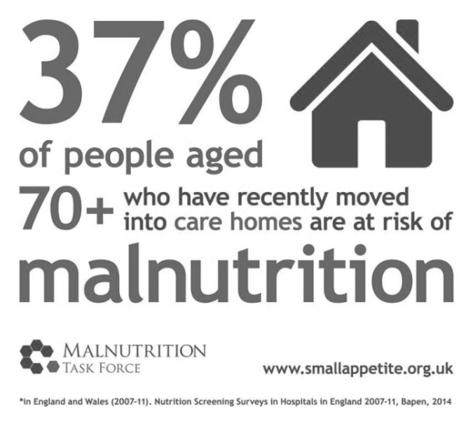
Disease Related Malnutrition (DRM)
10-14% of the 65+ population is at risk of malnutrition,
93% of those at risk of malnutrition are in the community.
Costs £29.5Billion in the UK.

Slide 43
Residents aged 65 years and over with BMI of <20kg/m² in Salford
The percentage of elderly people with suboptimal BMI is increasing year on year. With the oldest age group increasing by nearly 60%

Slide 44
Driver Diagram EAU project

Slide 45
Key Objectives

Slide 46
What have we achieved so far?
387 inpatient referrals in 6months.
40% of our target number of patient referrals
Additional patient contacts through group sessions
Promoting a ‘Food first’ approach through Nutritional Action Plans

Slide 47
Developed Appropriate Nutritional Pathways
 | Pathway 1 (MUST = 0) | Pathway 2 (MUST = 1) | Pathway 3 (MUST= 2+) | Pathway 4 (nil input required)
Dietetic screening | √ | √ | √ | √
Lunch and Learn | √ | √ | If desired | X
Nutritional Action Plan | X | √ | √ | X
Ongoing Dietetic Input | X | X | √ | X
Notes:
All pathways subject to professional assessment and clinical need!

Slide 48
Patients Contacts Split By Pathway

Slide 49
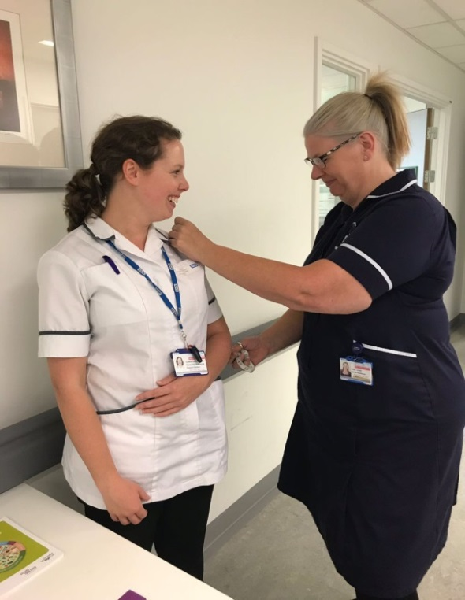
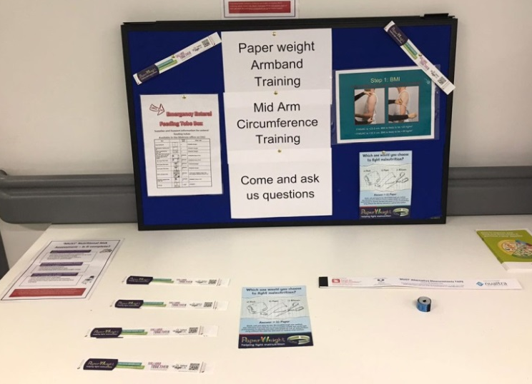
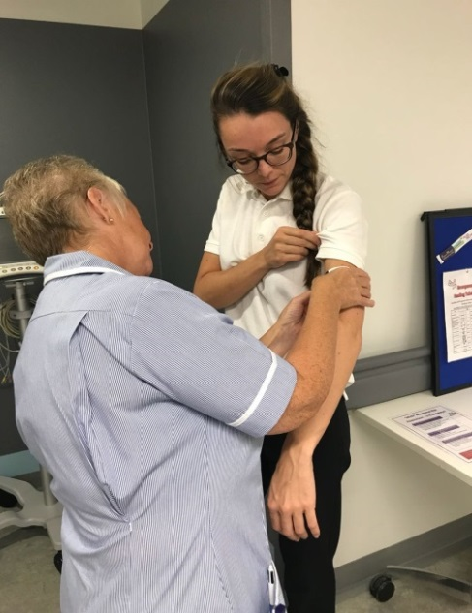
EAU Training

Slide 50
Referrals split by ward

Slide 51
Outcomes to date – 387 Salford residents
Notes:
Majority of our cohort of patients indicating that further input in community services would likely be beneficial
Large proportion of patient started EOL care in hospital or passed away in hospital or soon after discharge
These patient were sometimes not seen by the project due to commencing EOL care raising a query about the appropriateness of the referrals.

Slide 52
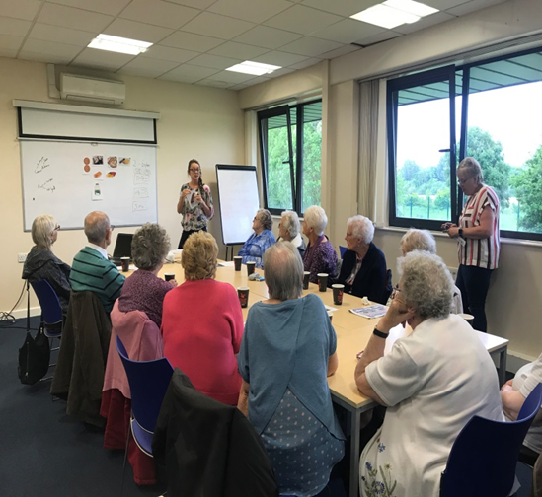
Lunch and Learn sessions

Slide 53
What’s next?
Look at the usefulness of MUAC on EAU
Roll out Daily weights scheme on EAU
Look at admissions whilst awaiting Community Dietetic input
Scale up Lunch and learns to cover a larger area
Look at clinical outcome data e.g. MUAC, weight trends, BMI trends etc.

Slide 54
Dysphagia Care Home Champions Innovation
Laura O’Shea – Adult SLT Lead
Notes:
Develop dysphagia care home champions. Project would run for 12 months to enable the champions to become established

Slide 55
Why?
Up to 60% care residents will have difficulties eating and drinking
Poor access to staff training and education affecting quality of management
Consequence can be patients are fed with unsafe diet and fluids increasing risk of choking, aspiration pneumonia and possible admission to hospital

Slide 56
Focus for Champions
Introduction and establishment of IDDSI
Establishment and confidence of supporting patients who are Risk feeding
Develop a risk assessment

Slide 58
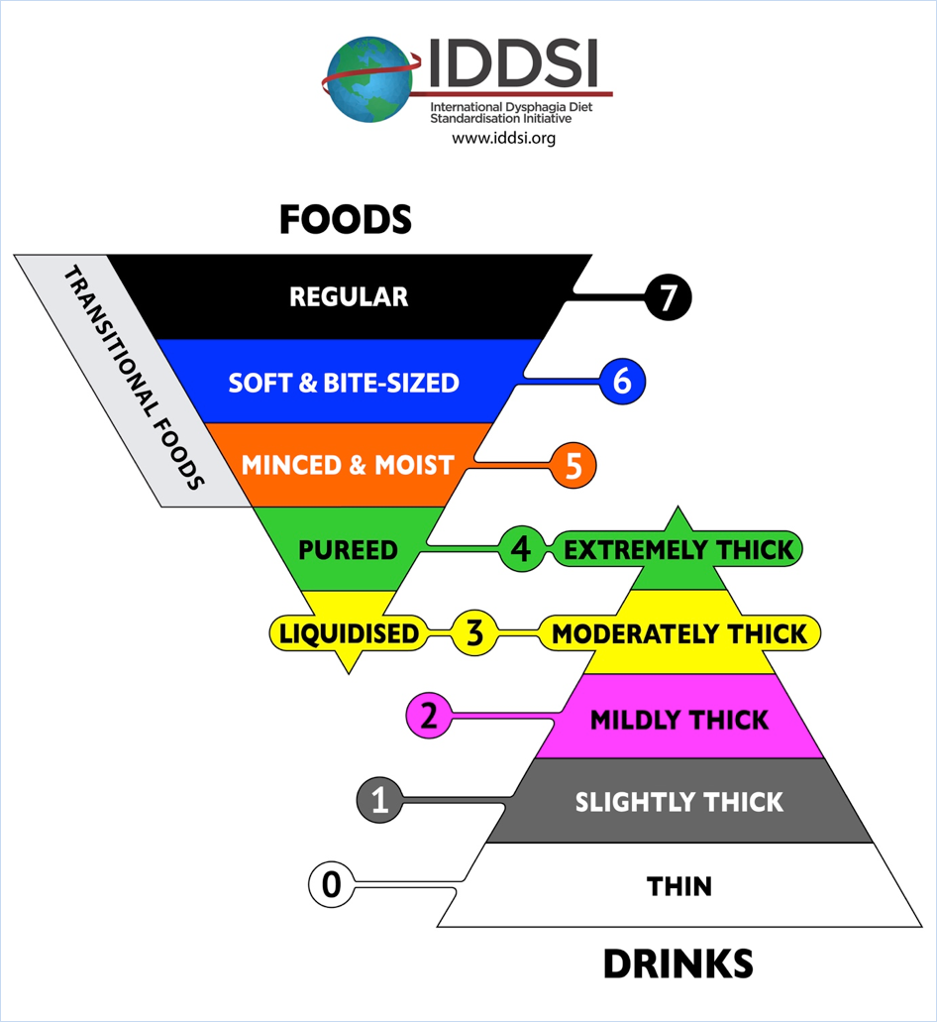
IDDSI – What is it?
International Dysphagia Diet Standardisation Initiative
Notes:
International initiative to provide safer descriptions of modified diet and fluids
It is used for individuals with dysphagia of all ages, in all care settings, and for all cultures.
The IDDSI framework consists of 8 levels (0-7). Levels are identified by text labels, numbers, and colour codes to improve safety and identification
When a person’s swallowing has been assessed they will be given specific recommendations based on the IDDSI model.

Slide 59
Risk feeding protocol
Poor awareness in care homes with risk feeding
Seen as an easy option by care homes
May use terminology inappropriately
Protocol not communicated and resident given inappropriate foods/fluids
Over reliance on SLT and inappropriate referrals to the service
Advanced Care Planning may be missed
Unnecessary hospital admissions
Notes:
Protocol successfully implemented in Salford (across acute and community settings)
Framework to support people feeding at risk
Alert on EPR in place
e.g. given soft food options rather than normal diet
Receive duplicate referrals for patients showing signs of difficulty swallowing but have protocol in place – needs greater understanding when appropriate to refer these patients back to the service
Care homes want the protocol in place for example, if patient reports that not keen on soft diet
e.g. patient was insisting on having ice cream so I did a risk assessment and she has been having ice cream (did not realise should have risk feeding discussions)
Protocol in place but no discussions as to what should be done if patient develops chest infection/ pneumonia

Slide 60
Benefits if correctly implemented
Supporting residents in decision making regarding risk feeding
Improved Quality of Life for residents
Reduced hospital admissions
Improved End of Life Care
Reduced inappropriate referrals to speech and language therapy

Slide 61
Our proposal
Recruit 1 WTE band 7 speech and language therapist
Identify 12 care homes based on residents with highest numbers prescribed thickener and highest referrers to SLT service
Identify 2 senior members of staff for each care home to be dysphagia care homes champions
Develop training package and resources
Roll out to identified care homes and evaluate

Slide 62
Measuring success
Baseline number of hospital admissions from care homes with risk feeding protocol in place and repeat at end of project
Number of care homes identified and numbers of staff trained
Qualitative measure of staff confidence in understanding and managing dysphagia and understanding of risk feeding protocol – completed at baseline and at end of project
No of staff who have accessed eLearning

Slide 63
Measuring success
All care homes will have written information and resources for relatives
Evidence of paperwork and pathways in care plans –risk feeding, risk assessment for relatives feeding residents with dysphagia and discussions re advanced care planning
Evidence of documentation in care plans/food and fluid charts with IDDSI descriptions for patients with dysphagia
All care home staff are able to answer questions relevant to IDDSI descriptors and risk feeding when asked (through spot checks, questionnaires and interviews)

Slide 64
Maintaining success
Resource pack available for additional individual care homes requiring training for dysphagia champions
Community SLT team able to provide training to individual additional care homes within current staffing resources once project has finished
Able to provide ongoing dysphagia champion link meetings on biannual basis to all trained champions for updates once project has finished

Slide 65
CHORUS Project
CHampioning Oral caRe in CommUnity Services
Notes:
In introduction need to like Oral Health to Malnutrition

Slide 66
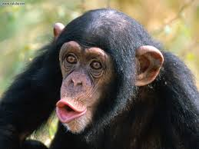
A mouth's main job is to let people eat
It has red lips to make it look neat
With pearly white teeth
And a chin underneath
And a tongue, just to make it complete
A mouth can have lots of fun
It can eat an ice-cream or a bun
Scoff fish and chips
And make use of its lips
When snogging needs to be done

Slide 67
FACTS & FIGURES
http://www.nationalsmilemonth.org
Tooth loss and dentures
Only 6% of adults have no natural teeth. In 1978, the figure was as high as 37% in Wales
74% of all adults have had a tooth extracted
19% cent of adults have full or partial dentures
The number of adults with 21 or more natural teeth has risen to 86% in England, Wales and Northern Ireland. In 1978, this was as low as 68% in Northern Ireland
Other oral health indicators
84% of all adults have at least one or more fillings
Each adult has an average of 7 fillings
31% of adults have tooth decay
66% have visible plaque
29% suffer from regular dental pain

Slide 68
CHORUS - (CHampioning Oral caRe in commUnity Services)
Background
There are over 35 care homes in Salford
It has been highlighted that there is a lack of training and guidance around oral hygiene in Salford Care Homes.
Local safeguarding concerns have also been raised by Community Dental Services.
CHORUS has been set up by the Palliative Care Trainers for Care Homes, Safeguarding team , Community dentist together with input specialist from RIS Healthcare.
Rationale / Aim
To implement Oral Hygiene Training to staff in Salford Care Homes
Through CHORUS provide a comprehensive Oral Hygiene Resource File to care homes to support care provided.
It is hoped with Training and Guidance there will be an increase in staff knowledge and in turn improve care home documentation and enhance patient outcomes and experience.

Slide 69
THE TEAM:
Dr Hilary Whitehead - Specialist in Special Care Dentistry and Specialist in Paediatric Dentistry, Pendleton Gateway, Pendleton Medical Centre
Supportive Palliative care nurses, Palliative Care Team, Salford Royal Foundation Trust
RIS healthcare – Excellence in oral management http://www.risproducts.co.uk/index.html
Safeguarding Team - Salford Clinical Commissioning Group
Barton Brook Care Home – Bupa
Salford Together - A partnership between Salford City Council, NHS Salford Clinical Commissioning Group, Salford Royal NHS Foundation Trust and Greater Manchester West Mental Health NHS Foundation Trust. http://www.salfordtogether.com/
Cath Rotherham - Health Facilitator (Learning Difficulties/Complex Needs), Joint Learning Difficulties Service, Salford City Council
Notes:
Talk about meetings – How the group has grown – Challenges

Slide 70
Project Outline
Through regular multi-disciplinary meetings an Oral Hygiene Resource File was created.
Small Pilot Project in 3 Salford Care Homes was carried out to look at care planning documentation.
Audit of the number of prescriptions issued
Implementation of Training both in house and at SRFT
An evaluation of the training/Resource file has had any impact.
Roll out across care homes in Salford

Slide 71
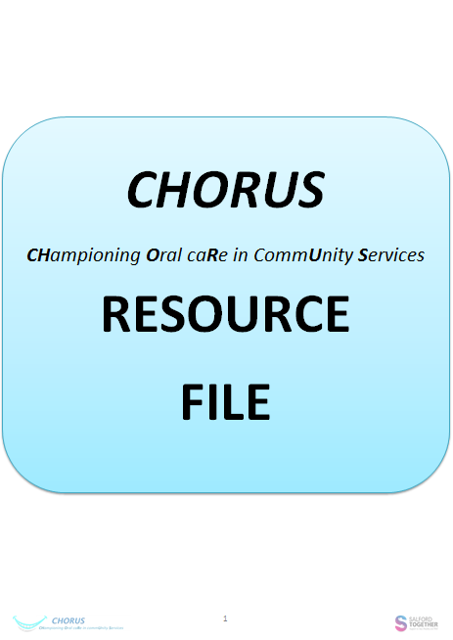
The Resource File - Provides guidance and templates in the following areas:
Assessment & Care Planning
Oral Conditions
Delivering Oral Care
Products to help with Oral Symptom Control
Referrals
Health Claim Forms
National Guidance
Local Policy & Documents
The Training – Provided in house by RIS
Anatomy & Physiology
Types of oral conditions
Management of oral conditions
How to perform oral care
Practical and interactive session
Case studies
Ongoing Support

Slide 72
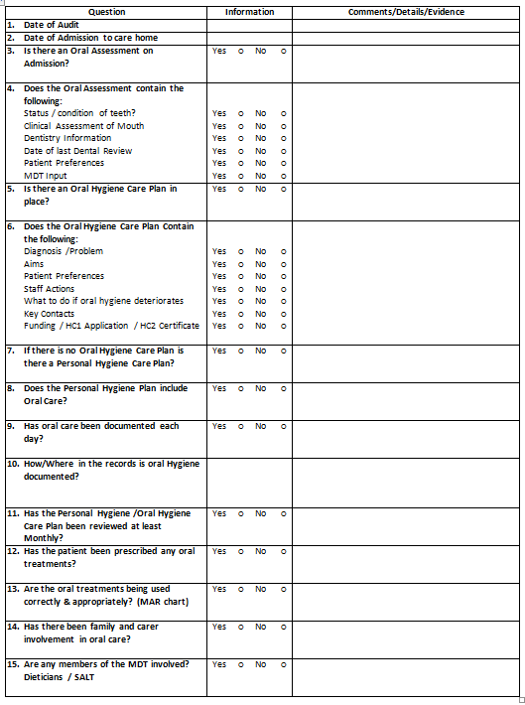
AUDIT TOOL
CHORUS Pilot Project – 3 Care Homes
Gain Baseline Data through an anonymous Oral Hygiene documentation Review
Implement Training and supply homes with Oral Hygiene Resource File
4 months Post Training and Resource File implementation, perform a second oral hygiene documentation review to evaluate if the Training & Resource file has had any impact on patient care

Slide 75
Biofilms are a collective of one or more types of microorganisms that can grow on many different surfaces. Microorganisms that form biofilms include bacteria, fungi and protists.
One common example of a biofilm dental plaque, a slimy buildup of bacteria that forms on the surfaces of teeth.
https://www.youtube.com/watch?v=RmwbqzxQjPs
Notes:
Bacteria from the oral biofilms may be aspirated into the respiratory tract to influence the initiation and progression of systemic infectious conditions such as pneumonia. Oral bacteria, poor oral hygiene, and periodontitis seem to influence the incidence of pulmonary infections,

Slide 76
SRFT Staff
L&D – Diane Hickford leading a task and finish group for the acute trust.
Regular training is to be provided by RIS

Slide 77
CHORUS - Implementation across the Care Home sector:
Provide all Salford Care Homes with a Resource File
Nominate Oral Health Champions in all Salford Care Homes
Provide Oral Care training to Care Home staff and Hospital staff
Increase recognition of oral conditions
Provide ongoing support to Care Homes
Ongoing review of Prescriptions, Safeguarding Alerts, Patient Records
For further support please contact
Marie Roberts - 0161 206 1868
Laura Forsythe – 0161 212 4468

Slide 78
Kafoodle Innovation Project. Digitising Menus
Revolutionising Nutrition in Health Care
Tony Ward – Senior Dietitian Salford Royal NHS Foundation Trust

Slide 79
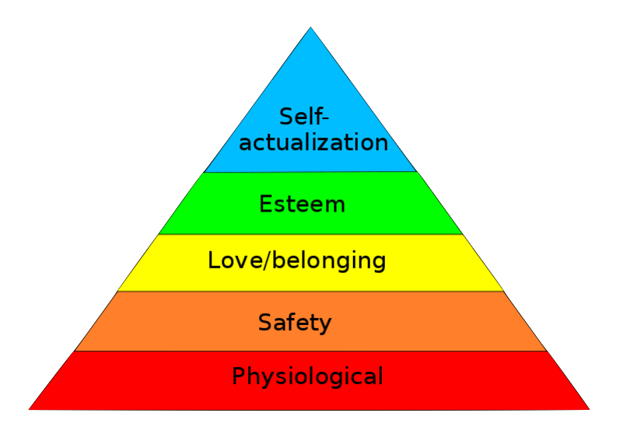
Malnutrition is common
About 1 in 3 in care homes and hospitals are malnourished
Food
Water
Kafoodle

Slide 80
Salford CCG innovation bid.
1 year project
5 nursing homes – ( we now have 6)
Cherry Trees – 32 Bed
Kenyon Lodge – 30 bed (half capacity)
Heartly Green – 30 beds (50% intermediate care)
The Broughtons – 42 Beds
Wentworth House – 25 beds
Amadeus – 39 beds
Improve transparency in nutrition and budgeting
Meet CQC criteria
Meet allergies Legislation
Save time and money
Improving service and reputation
The Bid

Slide 81
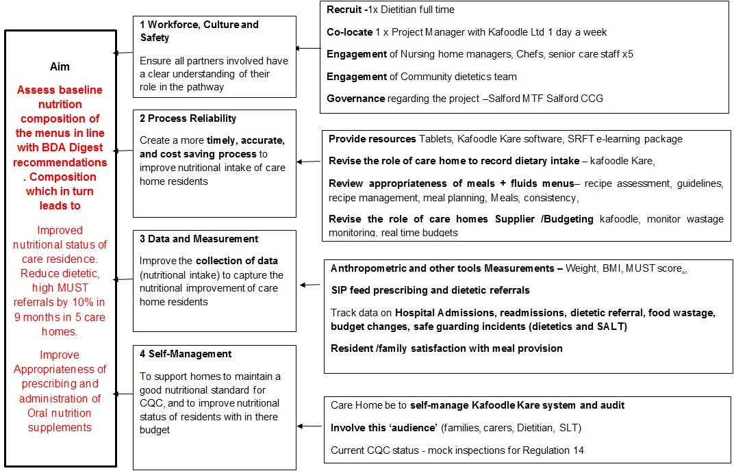
Driver Diagram

Slide 82
Aims:
To assess baseline data on nutritional status of care residences in 5 nursing homes.
Reduce dietetic high ‘MUST’ referrals by >10% in 9 months in 5 care homes by optimising the menu.
Ensure appropriate prescribing of supplements
Ensure the nutritional values of meals are adequate, while increasing efficiency in documentation, budgeting and meal planning.
Kafoodle Kare

Slide 83
LINK

Slide 84
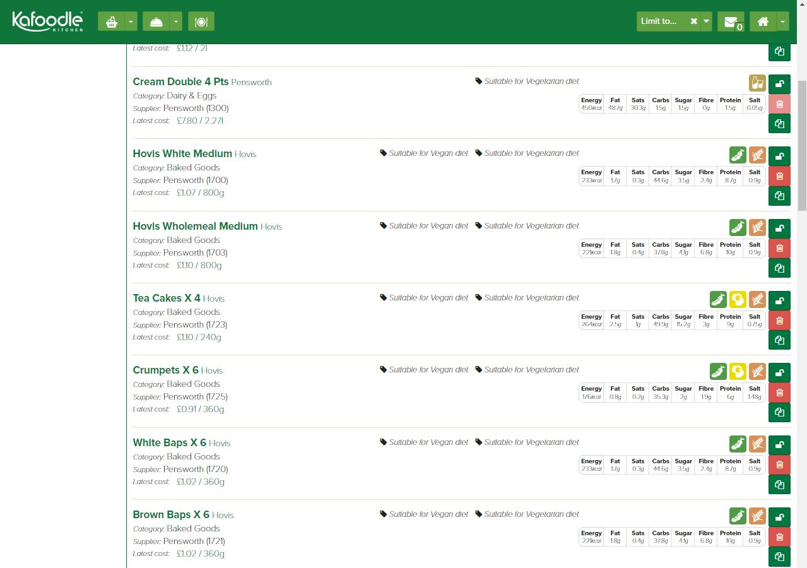
Ingredients

Slide 85
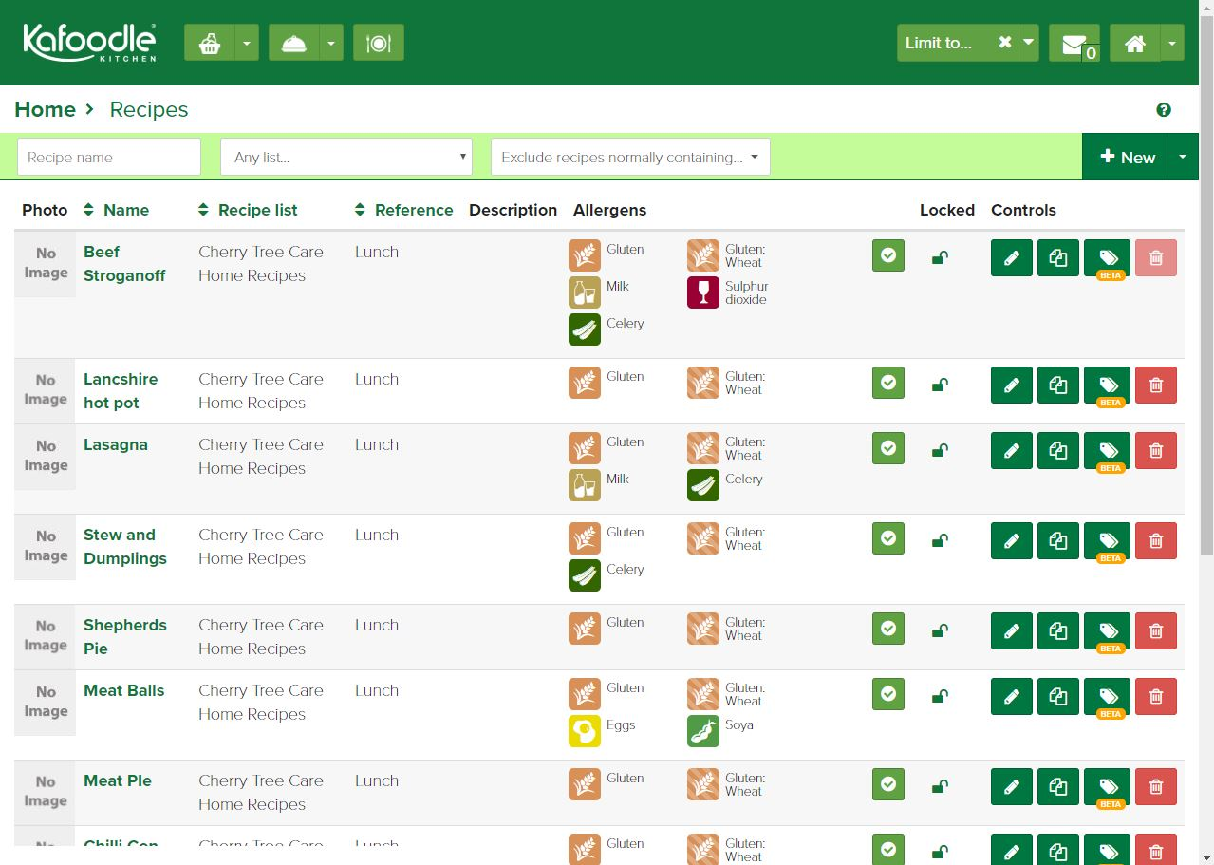
Recipes

Slide 86
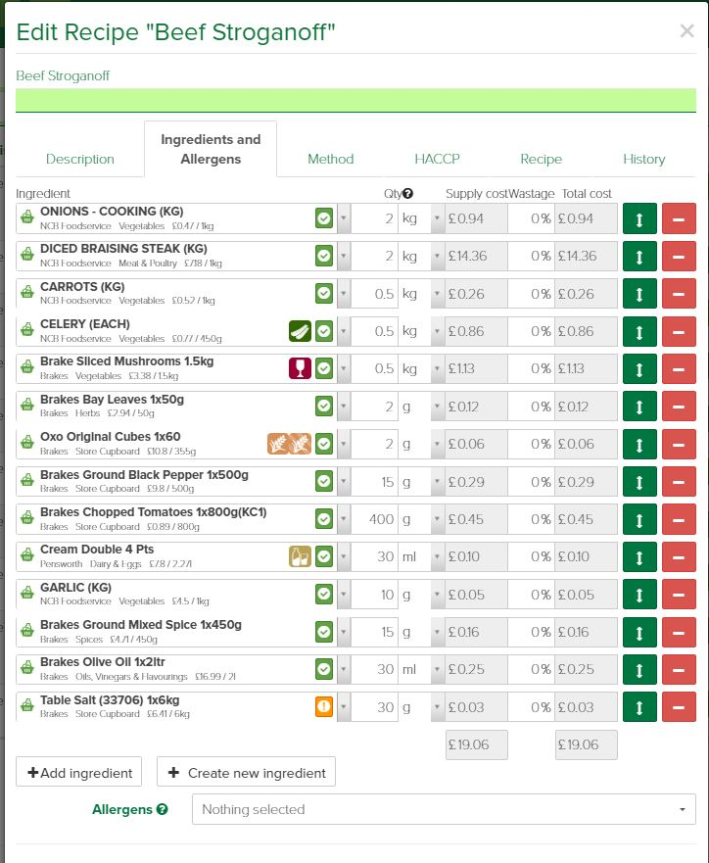
Recipes

Slide 87
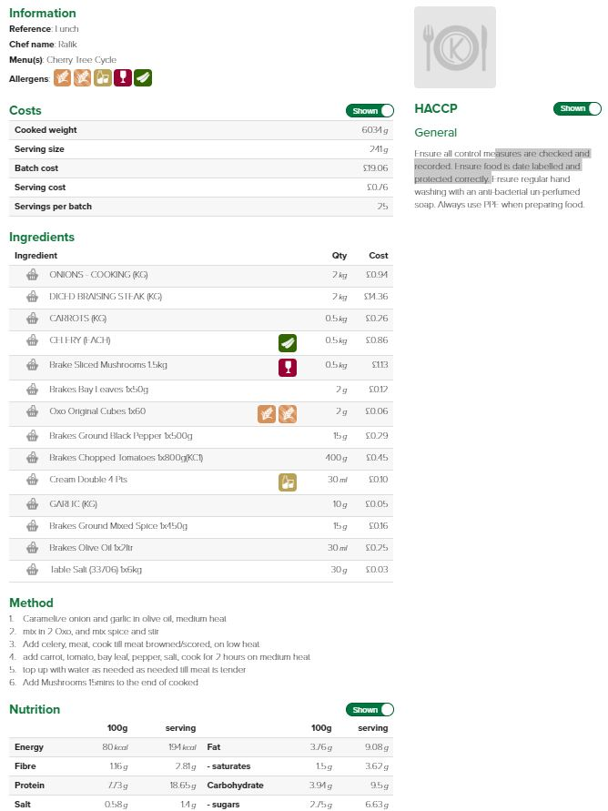
Recipe Sheets

Slide 88
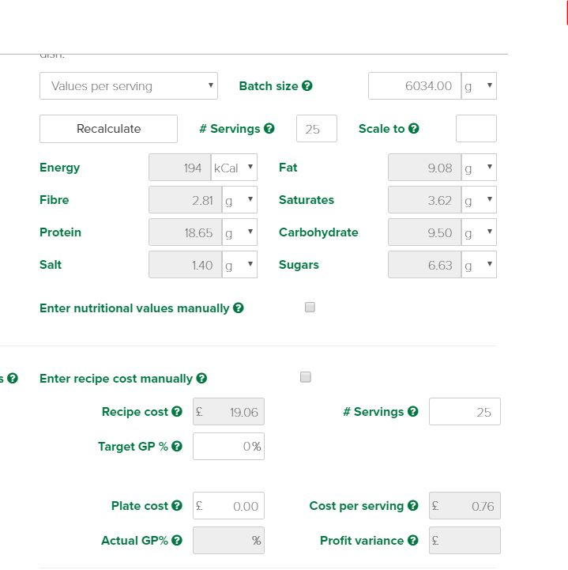
Nutrition/Cost

Slide 89
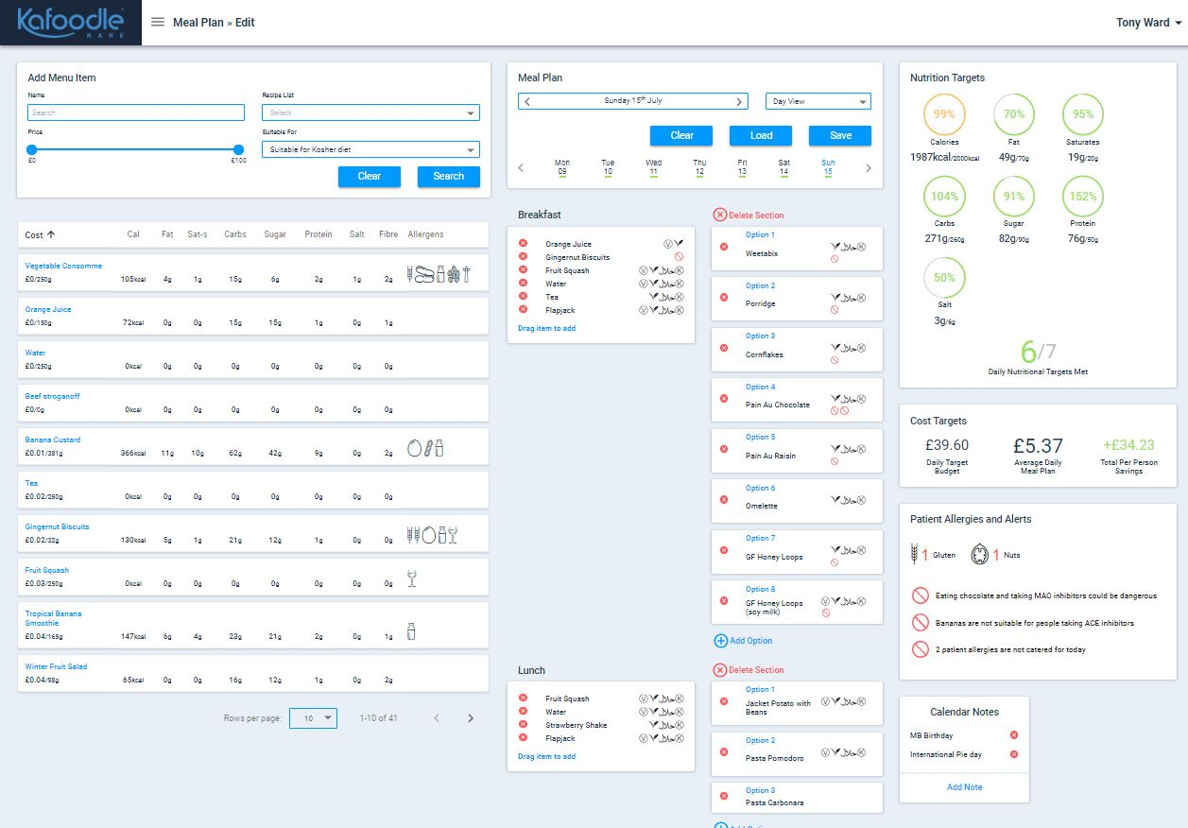
Meal Planning

Slide 90
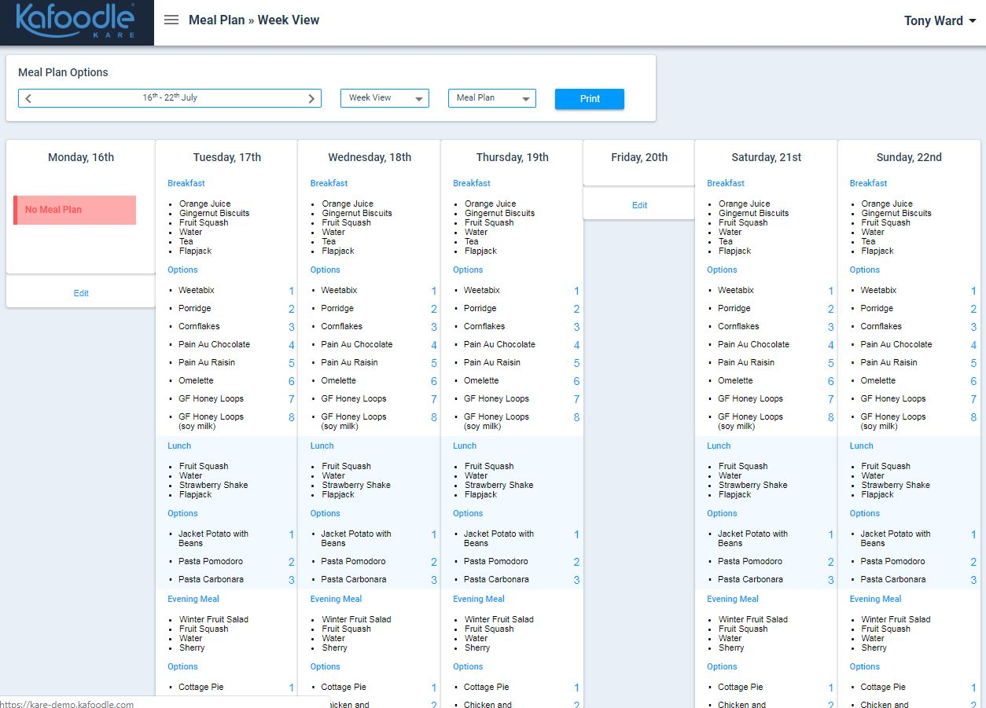
Meal Planning - Week

Slide 91
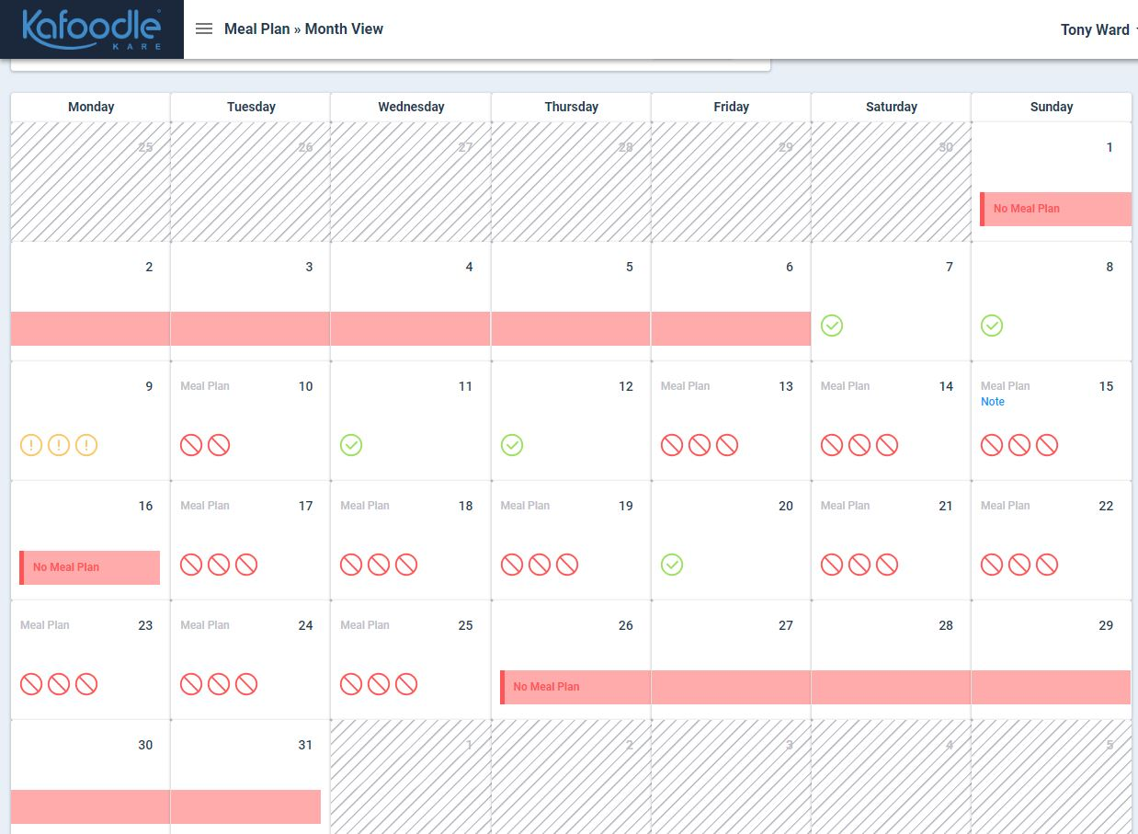
Meal Planning - Month

Slide 92
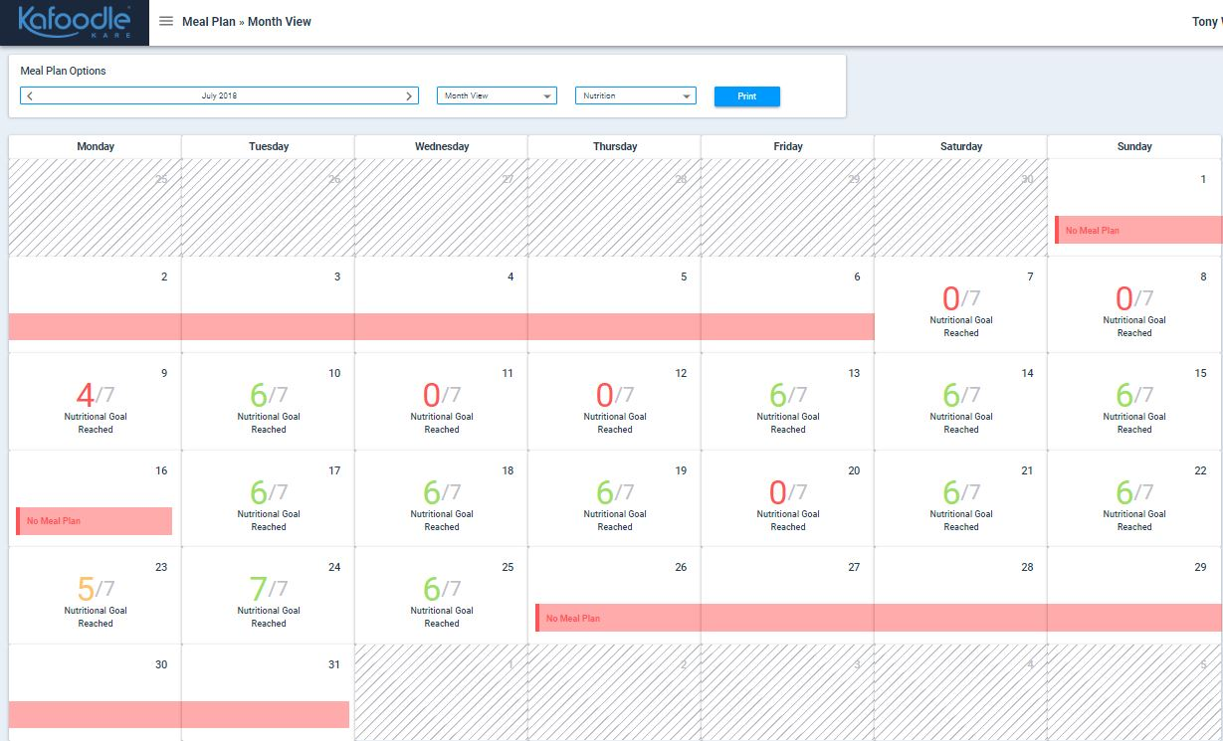
Nutrition Targets

Slide 93
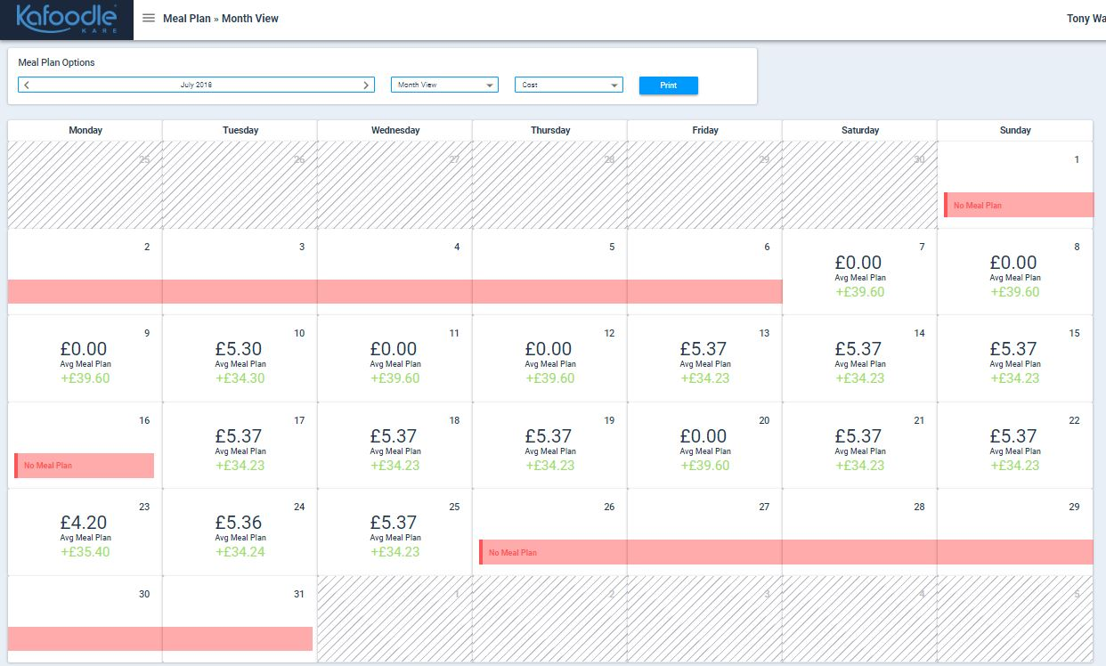
Budget

Slide 94
Recruiting – 6 homes signed up
Third parties companies
Observed
Process
Data collection – MUST, referrals, Weights, ONS cost
Data entry of ingredients
Time consuming
Recipes
None documented
Nutritional content, Allergens
Already seeing changes
More awareness of food fortification
Phase 1 – Current Status

Slide 95
Resident nutritional intake
Simple
More accurate
Real time
Safe
Improved food choices
Phase 2

Slide 96
Dietitians remote input
Intake review
Meal plans can be changed
Speech and Language Therapy
Change consistencies real time
IDDSI
Future

Slide 97
Thank you
Any questions?

Slide 98
Ageing Well in Salford, an Age Friendly City
Jean Rollinson
Director Age Well Strategy
Age UK Salford
Bernadette Elder
Chief Executive Officer Inspiring Communities Together

Slide 99
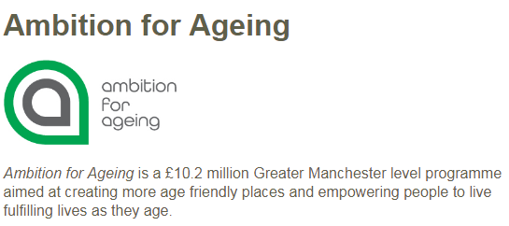
Notes:
GM approach – collaborative bid – City Councils commitment
In Salford – Partnership – City councils in GM led the bud but LDLs needed to be Vol secort AUKS, ICT, CVS manage this together
In wards of Broughton, Langworthy, and Weaste & Seedley there have already been over 80 projects which have been brought to life by and with older people in those
.
We have been able to provide up to £2000 for older people to invest in things which they believe will make a a difference and help people to feel less isolated and more involved in their communities. It is unsurprising then that quite a lot of request have been made for funds and equipment to run social lunches and evening get together in nearby community halls or in underused lounges in sheltered housing. We have been able to support these requests and – because of our involvement with the Salford preventing Malnutrtion work we have been able to informally – but successfully link these sessions to getting out messages about healthy eating and quashing the myths around malnutrition and dehydration
Although we can only make AfA investments in the 3 wards we have been quite imaginative in Salford in finding other resources and ways to replicate some good ideas in other areas of this City – a bit more about that later

Slide 100
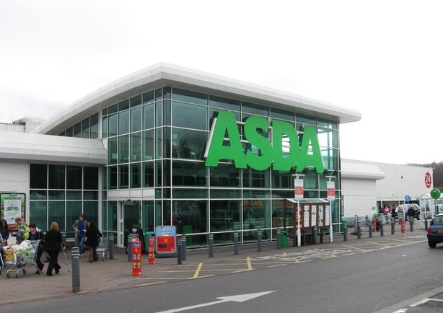
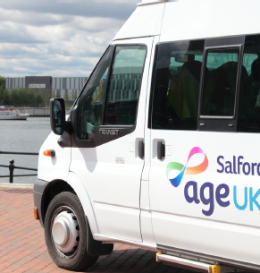
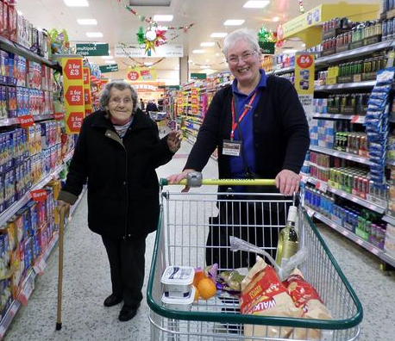
Notes:
If you’ve been to any events about malnutrition and dehydration you'll know that there are many – often non medical – reasons why people start to eat less and become at risk, Life changes after a serious illness , emotional changes after losing a partner and becoming disinterested in eating alone - or practical or practical changes such as no longer being able to get to the shops if the partners had done the driving - or the cooking.
One group of older people asked for funds to stimulate a bit of life into their sheltered housing communal room – they wanted some cooking pans and utensils crockery and tableware. They also wanted to go and get it themselves – and they used part of their funds to test out a social shopping trip to get the items they needed – but also to do some communal shopping in bulk – which saved them money, got them together and paved the way for their jointly organising a communal meal, inviting people who wouldn’t usually use the lounge to come on down..
In our early work in Salford we did set up camp at Asda in Swinton – with the managers support – and organised spent time accompanying people around the store using the backdrop of food glorious food, to have natural conversations about food choices and particularly around the idea that low fat choices and high calorie foods were not necessarily a bad thing for everyone – especially those who were under and losing weight unintentionally. We were then using the AfA opportunity able to identify older people who live in those wards and who had wanted to get out a bit more an opportunity to test out the social shopping model. People who went on the trips enjoyed trying different shops – and the chance to have a chat with others. We offered an ‘assisted’ shopping trip to enable people with mobility difficulties to be included . We are currently evaluating this investment and looking at how sustainable it might be once the Afa investment was no longer available.
These examples of bringing people together, socialising, social eating, assisted shopping are good examples of how the Voluntary sector can use its skills and resources not only to bring people together but also through our close working relationships with NHS, Social care professionals we can play an active and practical role in help in to tackle some and prevent some of the causes of malnutrition in older people – and contribute to reducing the impact and financial and human cost.

Slide 101
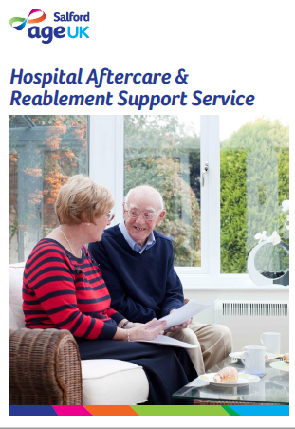
Notes:
As well as our role in the AfA programme AUKS along with our other VCSE partners also run services which can play a part. At AUKS in our pilot year working to prevent malnutrition, we realised that our HAC service was well placed to help test out the first prototype of what has since become the Paper Weight Armband.
.Poss. Hac case study about the couple we supported – dementia eating meals etc –help to eat in Hospital
The service which is based in A&E provides not only ‘in hospital support but also follow up at home to older people who may be OK medically but temporarily vulnerable due to their age or home circumstances. Our first film shows how, hospital aftercare staff doing home visits regularly chat to people about their concerns and also check the fridge in case people are not yet confident to go to the shops. This led to us realising that if trained to use the PaperWeight armband they could potentially help reach people who might be falling through gaps in other services
Rolling on a year or so and when an opportunity arose to make a case to have Dietitians based in EAU – it was unthinkable that this NHS innovation bud should not only include exploring how the AUKS hospital aftercare team could then further support people identified by the Dietitians but that we could also – through funding available in the AfA programme provide ‘social’ eating help in the Community
Over to Bernadette to expand on Lunch and Learns

Slide 102
Notes:
Bernadette to describe
How and where ICT set up the lunch and learn events – where the social , practical and medical issues around under eating could be explored in a friendly, accessible, community setting.
Use stuff from ICT EAU report and from film?
Link it back to Andrea and Vanda who have been supporting the social lunch developments as part of AfA are both able to help have natural, appropriate conversations with older people who may be at risk – and who haven’t ( yet) been to A&E. ie supporting people after aa hospital episode via the referral from the EAU project dietitians or introduced by Age Uk Salford Hospital aftercare team – we are also now able to identify and help people in the community before their health / weight has deteriorated to that stage
Etc etc
This leads onto us in the VCSE – who are often involved with other projects to help join the dots and transfer leaning from other approaches – the mots notable one being to help prevent falls in older people – Salford was at the wrong end of the NHS table in terms of the numbers of Hospital admissions due to falls and we were able to use this experience the work we had done to address that - to start to redesign our materials and approach to preventing malnutrition.

Slide 103
Notes:
A quick run through the materials produced….
Excellent example on genuine co-production,
using the resources of the Voluntary sector – training volunteers, front line workers outside not just inside the NHS etc.
Power of working together

Slide 104
Notes:
Say a bit about
the Wellbeing champion role and how this has helped to deliver falls prevention and eating well messages.
The ICO, Salford Together and ICT role in running Community Assets as part of that group in helping to shape the VCE role in the new model of H&SC – recognising that everyone needs to be involved in making change to the populations health - and involving as many people as possible is in everyone's interest.
This overall approach that good health means people, places, housing, transport, shopping, money, relationships, purpose etc etc – led to a discussion with the then xxxx (Ian A) about how Salford could continue its work in recognition of its importance and that was how Salford embarked on its journey to become an Age Friendly City. This WHO programme seemed to provide a relevant and internationally recognised framework for continuing to the recognise everyone’s role in improving lives
Etc etc

Slide 105
Notes:
Bit about the journey – from Helens / your slides
Sign up by City Mayor date
Baseline Plan
Films
Alliance
Status renewed – uploading progress
Etc etc

Slide 106
Notes:
Manchester AFC
GM Age Friendly Hub
GM Age Friendly Strategy
Andy Burnham – GM the first Age Friendly City Region – all GM areas have committed tot his (Salford and Manchester had already been accepted )
Our renewed status celebrated only this week on International OP Day with the leaflet illustrated

Slide 107
Notes:
Mention some examples from the Slide.
Perhaps draw it all together in some way??
Salford has been successful in getting recognition and trust in its work to tackle preventable malnutrition and address dehydrator because it has
Recognised and valued partnership working in practice
Understood and worked with the VCSE Sector in active, equal partnerships - and sen how productive and powerful that can be - bringing resources ££££ but also time, skills and a different relationship with the public / older people.
Opportunity to try out new things as the VCSE sector does work differently and with fewer constraints ( decision making- and action can be much quicker)
Enabled linkages to be made to other programmes saving money and time as shown in the examples of using existing VCD services, funded programmes (AfA)and GM strategic priorities e,g, GM Age Friendly Strategy as a platform for seeing ‘single’ messages such as malnutrition or falls in the wider context – and thus able to harness greater attention and support
THANK YOU!

Slide 108
What have you learnt?
What will you do?
#MAW2018
@GMNandH
@PArmband

